Slide 1
Link Layer, SDN, Course Summary
Qiao Xiang
https://qiaoxiang.me/courses/cnns-xmuf21/index.shtml
12/16/2021
This deck of slides are heavily based on CPSC 433/533 at Yale University, by courtesy of Dr. Y. Richard Yang.

Slide 2
Outline
Admin and recap
Link layer
Software defined networking
Course Summary

Slide 3
Recap: Link Layer Services
Framing
encapsulate datagram into frame, adding header, trailer and error detection/correction
Multiplexing/demultiplexing
frame headers to identify src, dest
Reliable delivery between adjacent nodes
we learned how to do this already !
seldom used on low bit error link (fiber, some twisted pair)
common for wireless links: high error rates
Media access control
Forwarding/switching with a link-layer (Layer 2) domain

Slide 4
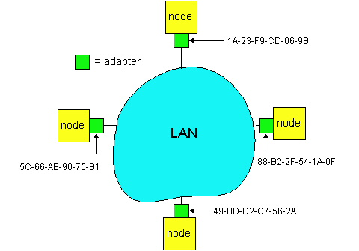
Recap: Adaptors Communicating
datagram
link layer protocol
receiving
node
sending
node
frame
frame
adapter
adapter
link layer typically implemented in “adaptor” (aka NIC)
Ethernet card, modem, 802.11 card, cloud virtual switch
adapter is semi-autonomous, implementing link & physical layers
in most link-layer, each adapter has a unique link layer address (also called MAC address)

Slide 5
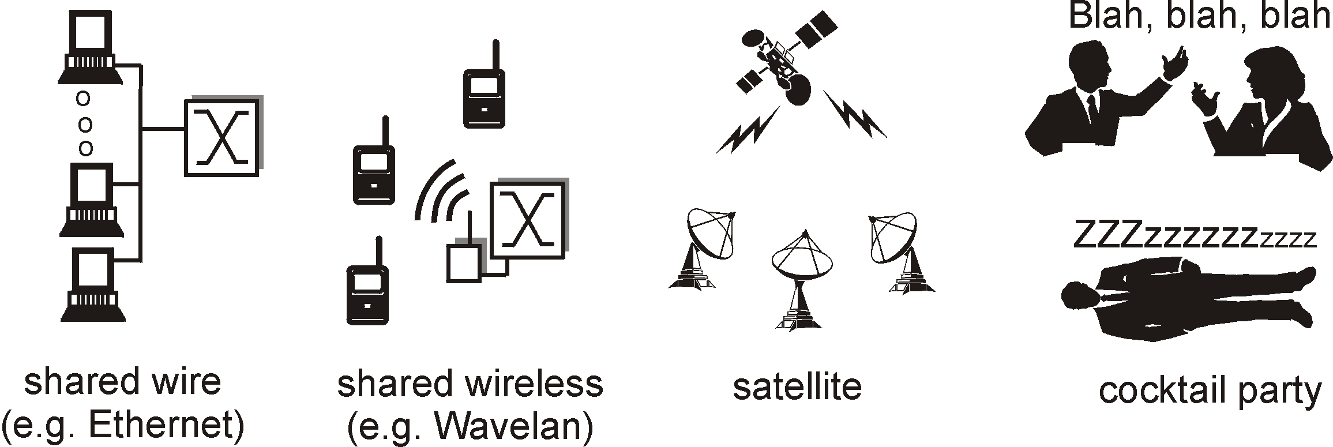
Recap: Multiple Access Links and Protocols
Many link layers use broadcast (shared wire or medium)
traditional Ethernet; Cable networks
802.11 wireless LAN; cellular networks
satellite
Problem: if two or more simultaneous transmissions, due to interference, only one node can send successfully at a time (see CDMA later for an exception)

Slide 6
Recap: Ideal Mulitple Access Protocol
Broadcast channel of rate R bps
Efficiency: when only one node wants to transmit, it can send at full rate R
Rate allocation:
simple fairness: when N nodes want to transmit, each can send at average rate R/N
we may need more complex rate control
Decentralized:
no special node to coordinate transmissions
no synchronization of clocks
Simple

Slide 7
Recap: Random Access Protocols
Examples of random access MAC protocols:
slotted ALOHA and pure ALOHA
CSMA and CSMA/CD, CSMA/CA
Ethernet, WiFi 802.11
Key design points:
when to access channel?
how to detect collisions?
how to recover from collisions?

Slide 8

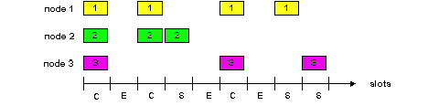
Slotted Aloha [Norm Abramson]
Time is divided into equal size slots (= pkt trans. time)
Node with new arriving pkt: transmit at beginning of next slot
If collision: retransmit pkt in future slots with probability p, until successful.
Success (S), Collision (C), Empty (E) slots

Slide 9
Slotted Aloha in Real Life
call setup in GSM
MS
BTS
Notations:
Broadcast control channel (BCCH): from base station, announces cell identifier, synchronization
Random access channel (RACH): MSs for initial access, slotted Aloha
access grant channel (AGCH): BTS informs an MS its allocation
standalone dedicated control channel (SDCCH): signaling and short message between MS and an MS
Traffic channels (TCH)
RACH (request signaling channel)
AGCH (assign signaling channel)
SDCCH (request call setup)
SDCCH message exchange
SDCCH (assign TCH)
Communication

Slide 10
Slotted Aloha Efficiency
Q: What is the fraction of successful slots?
suppose n stations have packets to send
suppose each transmits in a slot with probability p
- prob. of succ. by a specific node: p (1-p)^{(n-1)}
- prob. of succ. by any one of the N nodes
S(p) = n * Prob (only one transmits)
= n p (1-p)^{(n-1)}

Slide 11
Goodput vs. Offered Load for Slotted Aloha
S = throughput = “goodput”
(success rate)
Slotted Aloha
0.5
1.0
1.5
2.0
G = offered load = np
when p n < 1, as p (or n) increases
probability of empty slots reduces
probability of collision is still low, thus goodput increases
when p n > 1, as p (or n) increases,
probability of empty slots does not reduce much, but
probability of collision increases, thus goodput decreases
goodput is optimal when p n = 1

Slide 12
Dynamics of (Slotted) Aloha
Slotted Aloha has maximum throughput when np = 1
Implies we need to adjust p as the number of backlog stations varies.
Early design question: what is the effect if we do not change p-–use a fixed p
Assume we have a total of m stations (the machines on a LAN):
n of them are currently backlogged, each tries with a (fixed) probability p
the remaining m-n stations are not backlogged. They may start to generate packets with a probability p_{a}, where p_{a} is much smaller than p

Slide 13
Model
n backlogged
each transmits with prob. p
m-n: unbacklogged
each transmits with prob. p_{a}

Slide 14
Dynamics of Aloha: Effects of Fixed Probability
- assume a total of
m stations
p_{a} << p
success rate is the departure rate, the rate the backlog is reducing
desirable stable point
successful transmission rate at offered load np + (m-n)p_{a}
dep.
and
arrival
rate
of
backlogged
stations
new arrival rate: (m-n) p_{a}
undesirable stable point
0
offered load = 1
m
n: number of backlogged
stations
Lesson: if we fix p, but n varies, we may have an undesirable stable point

Slide 15
Summary of Problems of Aloha Protocols
Problems
slotted Aloha has better efficiency than pure Aloha but clock synchronization is hard to achieve
Aloha protocols have low efficiency due to collision or empty slots
when offered load is optimal (p = 1/N), the goodput is only about 37%
when the offered load is not optimal, the goodput is even lower
undesirable steady state at a fixed transmission rate, when the number of backlogged stations varies
Ethernet design: address the problems:
optimal transmission rate

Slide 16
The Basic MAC Mechanisms of Ethernet
get a packet from upper layer;
K := 0; n := 0; // K: control wait time; n: no. of collisions
repeat:
wait for K * 512 bit-time;
while (network busy) wait;
wait for 96 bit-time after detecting no signal;
transmit and detect collision;
if detect collision
stop and transmit a 48-bit jam signal;
n ++;
m:= min(n, 10), where n is the number of collisions
choose K randomly from {0, 1, 2, …, 2^{m}-1}.
if n < 16 goto repeat
else give up

Slide 17
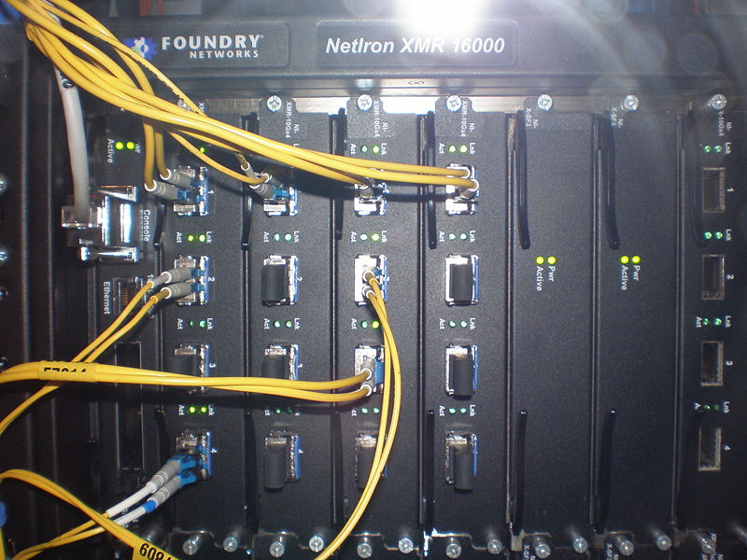
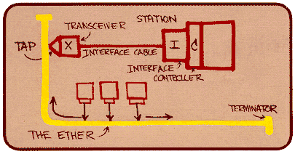
Ethernet
“Dominant” LAN technology:
First widely used LAN technology
Kept up with speed race: 10 Mbps, 100 Mbps, 1 Gbps, 10 Gbps
Metcalfe’s Ethernet
sketch

Slide 18
Outline
Admin and recap
Link layer
Ethernet switch

Slide 19
Ethernet Switch
link-layer device: takes an active role
store, forward Ethernet frames
examine incoming frame’s MAC address, selectively forward frame to one-or-more outgoing links when frame is to be forwarded on segment, uses CSMA/CD to access segment
transparent
hosts are unaware of presence of switches
plug-and-play, self-learning
switches do not need to be configured

Slide 20



Switch: Multiple Simultaneous Transmissions
hosts have dedicated, direct connection to switch
switches buffer packets
Ethernet protocol used on each incoming link, but no collisions; full duplex
each link is its own collision domain
switching: A-to-A’ and B-to-B’ can transmit simultaneously, without collisions
A
C’
B
6
1
2
5
4
3
B’
C
A’
switch with six interfaces
(1,2,3,4,5,6)

Slide 21
Switch Forwarding Table
Q: how does switch know A’ reachable via interface 4, B’ reachable via interface 5?
A
C’
B
6
1
2
A: each switch has a switch table, each entry:
(MAC address of host, interface to reach host, time stamp)
looks like a routing table!
5
4
3
B’
C
A’
switch with six interfaces
(1,2,3,4,5,6)
Q: how are entries created, maintained in switch table?
something like a routing protocol?

Slide 22
Switch: Self-Learning
Source: A
Dest: A’
switch learns which hosts can be reached through which interfaces
when frame received, switch “learns” location of sender: incoming LAN segment
records sender/location pair in switch table
A
A A’
C’
B
6
1
2
5
4
3
B’
C
A’
MAC addr interface TTL
A
1
60
Switch table
(initially empty)

Slide 23
Switch: Frame Filtering /Forwarding
when frame received at switch:
1. record incoming link, MAC address of sending host
2. index switch table using MAC destination address
3. if entry found for destination then {
if destination on segment from which frame arrived then drop frame
else forward frame on interface indicated by entry
}
else flood /* forward on all interfaces except arriving
interface */

Slide 24
Self-Learning, Forwarding: Example
Source: A
Dest: A’
A
A A’
frame destination, A’, location unknown:
flood
C’
B
destination A location known:
6
1
2
A A’
A A’
A A’
A A’
selectively send
on just one link
A A’
5
4
3
B’
C
A’ A
A’
MAC addr interface TTL
A
1
60
switch table
(initially empty)
A’
4
60

Slide 25

Interconnecting Switches
self-learning switches can be connected together:
S₄
S₁
S₃
A
S₂
F
I
B
C
D
E
G
H
Q: sending from A to G - how does S₁ know to forward frame destined to G via S₄ and S₃?
A: self learning! (works exactly the same as in single-switch case!)

Slide 26
Self-Learning Multi-switch Example
Suppose C sends frame to I, I responds to C
S₄
S₁
S₃
A
S₂
F
I
B
C
D
E
G
H
Offline Exercise: show switch tables and packet forwarding in S₁, S₂, S₃, S₄

Slide 27
Institutional Network
mail server
to external
network
router
web server
IP subnet

Slide 28
Switches vs. Routers
application
transport
network
link
physical
both are store-and-forward:
routers: network-layer devices (examine network-layer headers)
switches: link-layer devices (examine link-layer headers)
both have forwarding tables:
routers: compute tables using routing algorithms, IP addresses
switches: learn forwarding table using flooding, learning, MAC addresses
datagram
frame
link
physical
frame
switch
network
link
physical
datagram
frame
application
transport
network
link
physical

Slide 29
Outline
Admin and recap
Link layer
Software defined networking
Motivation: from simple forwarding to network functions
Design overview

Slide 30
Alternative Design: Software Defined Networking
Instead of distributed computing, directly setting up the state of network devices.
Instead of distributed computing, setting up the state of network selected devices.
i
a
b
e
f
g
d
c
h
Discussion: key components of the architecture?

Slide 31
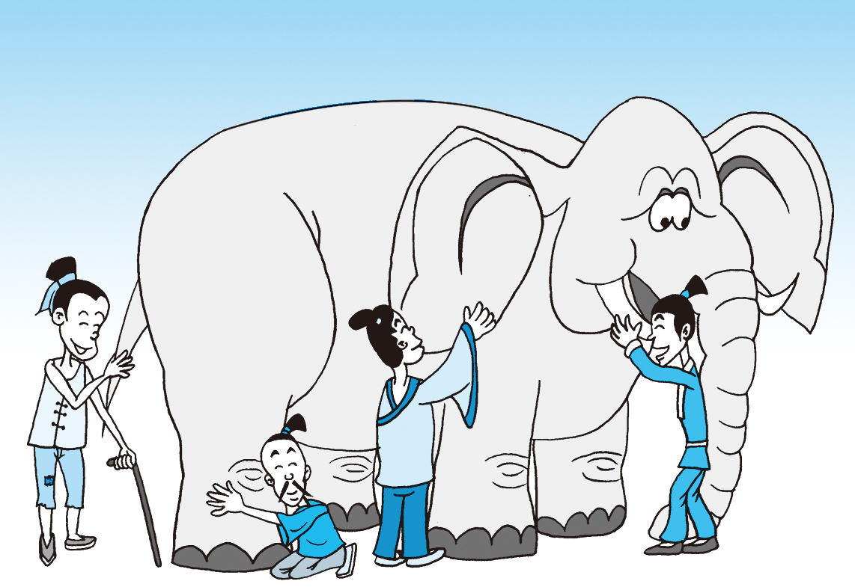
What is Software Defined Networking (SDN)?

Slide 32

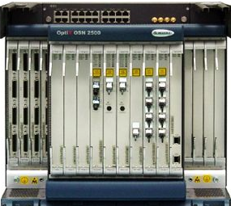
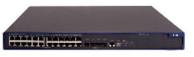
What is SDN: a “Main-Stream” View
Separation of data and control paths, with a logically centralized, programmable control plane
Traditional
SDN
Control
Control
standard control
protocol
Datapath
Datapath
Control
Datapath
Datapath
Control
Datapath
Datapath

Slide 33
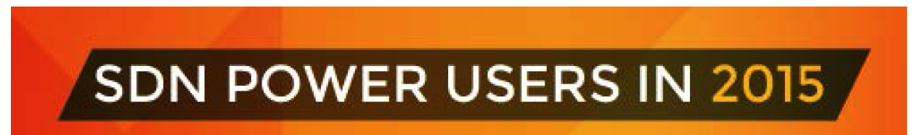
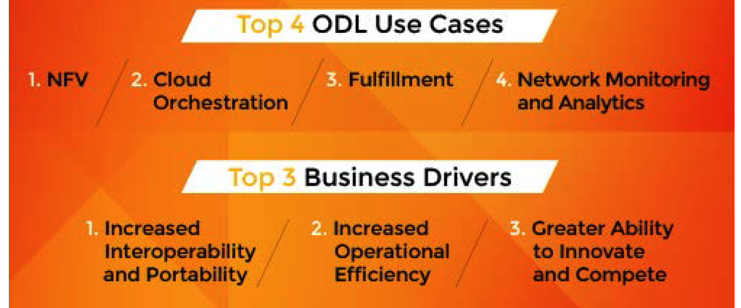
Some Use Cases of SDN
128 Companies responded
31% Telcos/Service Providers
24% Research/Academia
20% Enterprises
10% Services/Consulting
9% Software/Hardware
6% Other
Source: Neela Jacques, July 2015.

Slide 34
Why SDN (A “Wiseman” View)?
Distributed computing is hard, e.g.,
FLP Impossibility Theorem
Arrow’s Impossibility Theorem
Achieved good design for few distributed-computing tasks (e.g., state distribution, leader election).

Slide 35

An Evolution View of Intradomain Routing Toward SDN
Link State
Distance Vector
SDN
Control
Logically Central Link State
notification/
management/ control
protocol
Dijkstra
Distributed Bellman Ford
Distributed Link State
Dijkstra
Datapath
Distributed Bellman Ford
Distributed Link State
Dijkstra
Datapath
Distributed Bellman Ford
Distributed Link State
Datapath

Slide 36
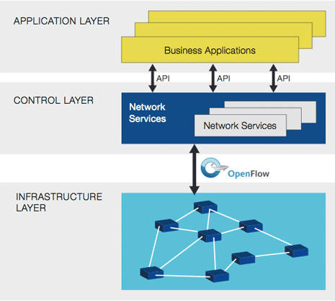
Software-Defined Networking (SDN)
Directly programmable
Agile
Centrally managed
Programmatically configured
Open standards-based and vendor-neutral
https://www.opennetworking.org/sdn-resources/sdn-definition

Slide 37
Outline
Admin and recap
Link layer
Software defined networking
Motivation: from simple forwarding to network functions
Design overview
Data path (OpenFlow)

Slide 38
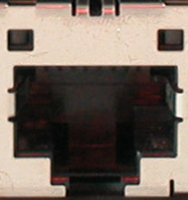
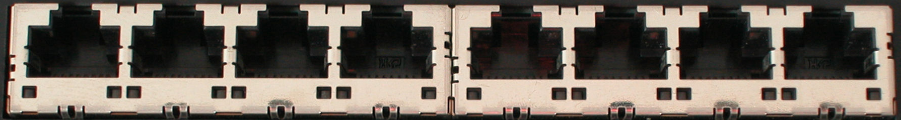
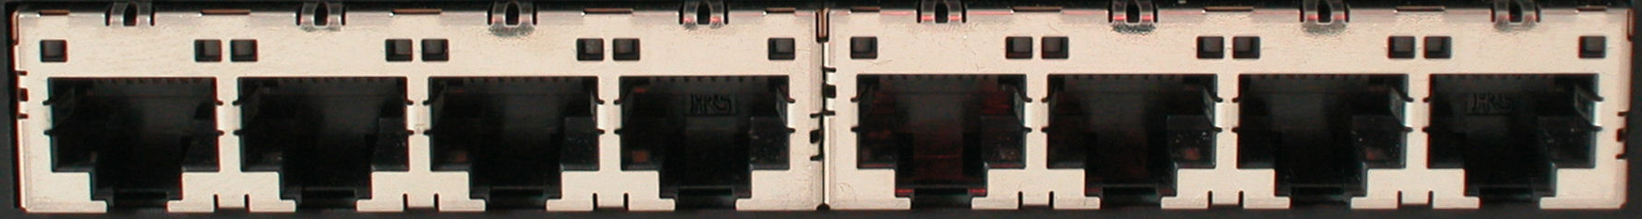

OpenFlow Datapath
Ethernet Switch
port 1
port 2
port 3
port 4
5.6.7.8
1.2.3.4

Slide 39

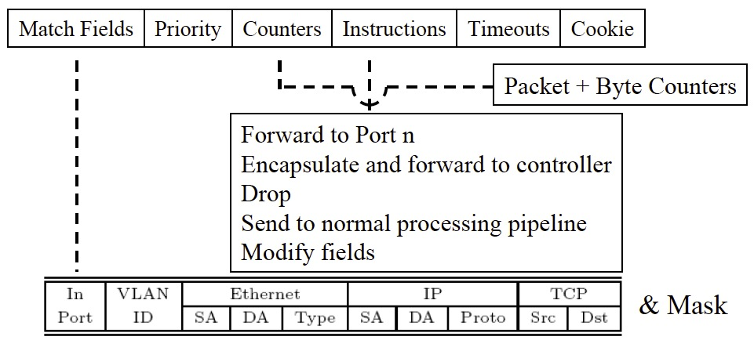
OpenFlow Datapath
Controller
OpenFlow Firmware
Software
Layer
PC
Flow Table
Hardware
Layer
port 1
port 2
port 3
port 4
5.6.7.8
1.2.3.4

Slide 40
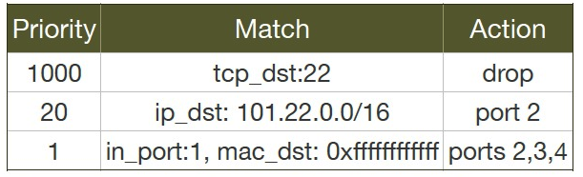
Datapath Model: OpenFlow

Slide 41
OpenFlow Datapath: Example
Controller
OpenFlow Firmware
PC
Software
Layer
Flow Table
MAC
src
MAC
dst
IP
Src
IP
Dst
TCP
sport
TCP
dport
Action
Hardware
Layer
*
*
*
5.6.7.8
*
*
port 1
port 1
port 2
port 3
port 4
5.6.7.8
1.2.3.4

Slide 42
OpenFlow Datapath: Examples
Switching
Switch
Port
MAC
src
MAC
dst
Eth
type
VLAN
ID
IP
Src
IP
Dst
IP
Prot
TCP
sport
TCP
dport
Action
*
*
00:1f:..
*
*
*
*
*
*
*
port6
Flow Switching
Switch
Port
MAC
src
MAC
dst
Eth
type
VLAN
ID
IP
Src
IP
Dst
IP
Prot
TCP
sport
TCP
dport
Action
port3
00:20..
00:1f..
0800
vlan1
1.2.3.4
5.6.7.8
4
17264
80
port6
Firewall
Switch
Port
MAC
src
MAC
dst
Eth
type
VLAN
ID
IP
Src
IP
Dst
IP
Prot
TCP
sport
TCP
dport
Forward
*
*
*
*
*
*
*
*
*
22
drop

Slide 43
OpenFlow Datapath: Examples
Routing
Switch
Port
MAC
src
MAC
dst
Eth
type
VLAN
ID
IP
Src
IP
Dst
IP
Prot
TCP
sport
TCP
dport
Action
*
*
*
*
*
*
5.6.7.8
*
*
*
port6
VLAN Switching
Switch
Port
MAC
src
MAC
dst
Eth
type
VLAN
ID
IP
Src
IP
Dst
IP
Prot
TCP
sport
TCP
dport
Action
port6,
port7,
port9
*
*
00:1f..
*
vlan1
*
*
*
*
*

Slide 44


OpenFlow Message Flows: Reactive Mode (pkt miss)
Controller
OpenFlow
Switch
PC
Rule
Action
Statistics
OpenFlow
Protocol pkt miss msg
OpenFlow
Switch
OpenFlow
Switch
flowtable lookup miss
Rule
Action
Statistics
Rule
Action
Statistics
pkt
OpenFlowSwitch.org
Notes:
44
44

Slide 45
OpenFlow Message Flows: Reactive Mode (flow mod)
Controller
pkt_miss handler
OpenFlow
Switch
PC
Rule
Action
Statistics
OpenFlow
Protocol flow_mod
OpenFlow
Switch
OpenFlow
Switch
pkt
Rule
Action
Statistics
Rule
Action
Statistics
OpenFlowSwitch.org
Notes:
45
45

Slide 46
OpenFlow Message Flows: Reactive Mode (forward)
Controller
OpenFlow
Switch
PC
Rule
Action
Statistics
OpenFlow
Switch
OpenFlow
Switch
pkt
Rule
Action
Statistics
Rule
Action
Statistics
OpenFlowSwitch.org
Notes:
46
46

Slide 47
Outline
Admin and recap
Link layer
Software defined networking
Motivation: from simple forwarding to network functions
Design overview
Data path (OpenFlow)
Control path (programming model) [Optional]

Slide 48

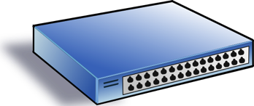
SDN Programming Model
Service/ Policy
Program Logic
Datapath Model
Datapath Model
Network State

Slide 49


An Example: A Simple SDN Controller
badPort = 22 // policy hostTbl = {A:1,B:2, C:3,D:4} // net view
def onPacketIn(p):
if badPort == p.tcp_dst: drop
else: forward([hostTbl(p.eth_dst)])
1
2
3
4
A
B
C
D
Assume only packets to A,B,C,D can appear.

Slide 50
Controller Program with Flow Table Management
hostTbl = {A:1,B:2,C:3,D:4}
def onPacketIn(p):
if 22 == p.tcp_dst: drop
installRule({‘match':{'tcp_dst':22}, ‘action’:[]})
else: forward([hostTbl(p.eth_dst)])
installRule({‘match’: {‘eth_dst’:p.eth_dst, ’tcp_dst’!=22},
‘action’:[hostTbl(p.eth_dst)]})
match does not support logic negation

Slide 51
Controller Program with Flow Table Management
hostTbl = {A:1,B:2,C:3,D:4}
def onPacketIn(p):
if 22 == p.tcp_dst: drop
installRule({‘priority’:1, ‘match’:{'tcp_dst':22}, ‘action’:[]})
else: forward([hostTbl(p.eth_dst)])
installRule({‘priority’:0, ‘match’: {‘eth_dst’:p.eth_dst},
‘action’:[hostTbl(p.eth_dst)]})

Slide 52
Does the Program Work?
Switch
EthDst:A,
TcpDst:80
{`priority`:0,’match’:{‘eth_dst’:A},'action':[1]}
EthDst:A,
TcpDst:22
A security bug!
Controller
def onPacketIn(p):
if 22 == p.tcp_dst: drop
installRule({`priority`:1,’match’:{‘tcp_dst':22},'action':[]})
else:
installRule({`priority`:0,’match’:{‘eth_dst’:p.eth_dst},
'action':[hostTbl(p.eth_dst)]})
forward([hostTbl(p.eth_dst)])
Notes:
Unfortunately, this program has a bug. To see where the program goes wrong, let’s watch what happens when we connect this controller to a single switch and let two packets arrive. Both packets have destination mac A. The red packet is to TCP destination 80, while the green packet is to TCP destination 22. When the red packet arrives, the switch has an empty flow table and sends the packet to the controller. The controller determines that the packet should be forwarded to the next hop, and installs the appropriate rule. The red packet returns to the switch and moves onward. Now, the port 22 packet arrives at the switch, and instead of being dropped or sent to the controller, it matches the low priority rule for Ethernet destination A and is therefore forwarded onward. This violates the user’s intentions and may represent a security violation.

Slide 53
OVS Approach: Using Exact Match
hostTbl = {A:1,B:2,C:3,D:4}
def onPacketIn(p):
if 22 == p.tcp_dst: drop
installRule({‘priority’:1, ‘match’:exactMatch(p), ‘action’:[]})
else: forward([hostTbl(p.eth_dst)])
installRule({‘priority’:0, ‘match’:exactMatch(p),
‘action’:[hostTbl(p.eth_dst)]})

Slide 54
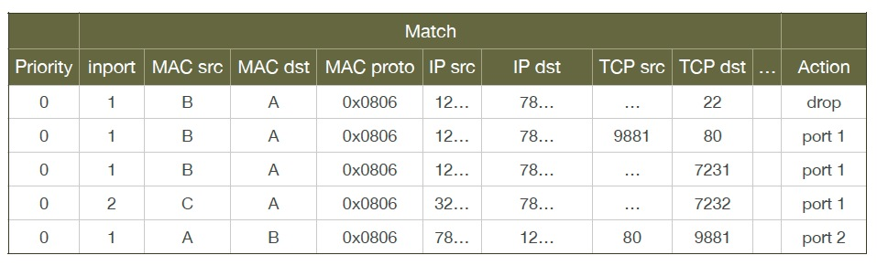
Problems of OVS Approach
Each new TCP flow delayed for flow setup (10-100 ms)
Number of flow table rules may exceed capacity (typically a few thousands)

Slide 55
Outline
Admin and recap
Link layer
Software defined networking
Motivation: from simple forwarding to network functions
Design overview
Data path (OpenFlow)
Control path (programming model)
Problems
What would you do?

Slide 56
Outline
Admin and recap
Link layer
Software defined networking
Motivation: from simple forwarding to network functions
Design overview
Data path (OpenFlow)
Control path (programming model) [Optional]
Course Summary

Slide 57
Synthesis: A Day in the Life of a Web Request
journey down protocol stack complete!
application, transport, network, link
putting-it-all-together: synthesis!
goal: identify, review, understand protocols (at all layers) involved in seemingly simple scenario: requesting www page
scenario: student attaches laptop to campus network, requests/receives www.tencent.com

Slide 58




A Day in the Life: Scenario
browser
DNS server
Comcast network
68.80.0.0/13
school network
68.80.2.0/24
web page
web server
Tencent’s network
64.233.160.0/19
64.233.169.105

Slide 59
A Day in the Life… Connecting to the Internet
DHCP
DHCP
UDP
IP
Eth
Phy
connecting laptop needs to get its own IP address, addr of first-hop router, addr of DNS server: use DHCP
DHCP
DHCP
DHCP
DHCP
DHCP request encapsulated in UDP, encapsulated in IP, encapsulated in 802.3 Ethernet
DHCP
DHCP
UDP
IP
Eth
Phy
DHCP
DHCP
DHCP
DHCP
router
(runs DHCP)
Ethernet frame broadcast (dest: FFFFFFFFFFFF) on LAN, received at router running DHCP server
Ethernet demuxed to IP demuxed, UDP demuxed to DHCP

Slide 60
A Day in the Life… Connecting to the Internet
DHCP
DHCP
UDP
IP
Eth
Phy
DHCP server formulates DHCP ACK containing client’s IP address, IP address of first-hop router for client, name & IP address of DNS server
DHCP
DHCP
DHCP
encapsulation at DHCP server, frame forwarded (switch learning) through LAN, demultiplexing at client
DHCP
DHCP
UDP
IP
Eth
Phy
DHCP
DHCP
DHCP
router
(runs DHCP)
DHCP
DHCP client receives DHCP ACK reply
Client now has IP address, knows name & addr of DNS
server, IP address of its first-hop router

Slide 61
A Day in the life… ARP (before DNS, before HTTP)
DNS
DNS
UDP
IP
Eth
Phy
before sending HTTP request, need IP address of www.tencent.com: DNS
DNS
DNS
ARP
ARP query
DNS query created, encapsulated in UDP, encapsulated in IP, encapsulated in Eth. To send frame to router, need MAC address of router interface: ARP
ARP
ARP reply
Eth
Phy
router
(runs DHCP)
ARP query broadcast, received by router, which replies with ARP reply giving MAC address of router interface
client now knows MAC address of first hop router, so can now send frame containing DNS query

Slide 62
A Day in the Life… Using DNS
DNS
UDP
IP
Eth
Phy
DNS
DNS server
DNS
UDP
IP
Eth
Phy
DNS
DNS
DNS
DNS
DNS
DNS
DNS
DNS
Comcast network
68.80.0.0/13
IP datagram forwarded from campus network into Comcast network, routed (tables created by RIP, OSPF, IS-IS and/or BGP routing protocols) to DNS server
router
(runs DHCP)
IP datagram containing DNS query forwarded via LAN switch from client to 1st hop router
demuxed to DNS server
DNS server replies to client with IP address of www.tencent.com

Slide 63
A Day in the Life…TCP Connection Carrying HTTP
HTTP
HTTP
TCP
IP
Eth
Phy
SYNACK
SYN
SYNACK
SYN
SYNACK
SYN
SYN
to send HTTP request, client first opens TCP socket to web server
router
(runs DHCP)
TCP
IP
Eth
Phy
TCP SYN segment (step 1 in 3-way handshake) inter-domain routed to web server
SYNACK
SYN
SYNACK
SYN
SYNACK
SYNACK
SYN
web server responds with TCP SYNACK (step 2 in 3-way handshake)
web server
64.233.169.105
TCP connection established!

Slide 64
A Day in the Life… HTTP Request/Reply
HTTP
HTTP
TCP
IP
Eth
Phy
web page finally (!!!) displayed
HTTP
HTTP
HTTP
HTTP
HTTP
HTTP
HTTP
HTTP
HTTP request sent into TCP socket
router
(runs DHCP)
IP datagram containing HTTP request routed to www.tencent.com
HTTP
HTTP
TCP
IP
Eth
Phy
HTTP
HTTP
HTTP
web server responds with HTTP reply (containing web page)
HTTP
web server
64.233.169.105
IP datagram containing HTTP reply routed back to client

Slide 65
Course Topics Summary
The Internet is a general-purpose, large-scale, distributed computer network
Major design features/principles
packet switching/statistical multiplexing
time-reversibility, queueing theory and performance analysis
layered architecture, hour-glass architecture
end-to-end principle
decentralized (social-technocal) architecture
e.g., DNS (hierarchy delegation), interdomain routing (peer-to-peer)
resource allocation framework
axiom-based design (NBS); optimization decomposition through duality
adaptive control
e.g., sliding window self clocking, AIMD adaptation, Ethernet exp backoff
tradeoff between theoretical impossibility and practice

Slide 66

First-Day Class: What is a Network Protocol?
A network protocol defines the format and the order of messages exchanged between two or more communicating entities, as well as the actions taken on the transmission and/or receipt of a message or other events.
Protocols that we have touched on?

Slide 67
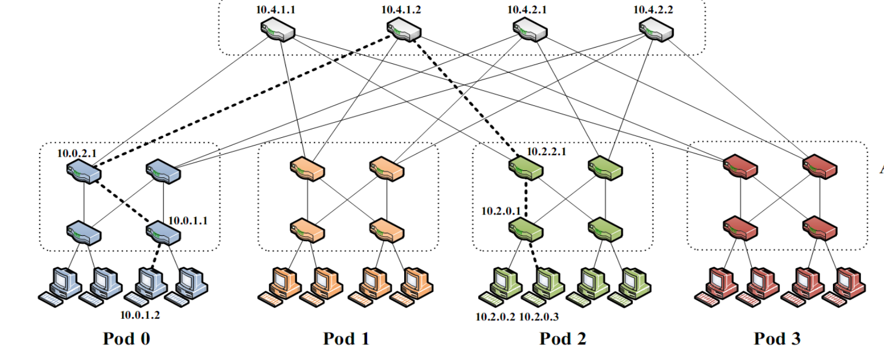
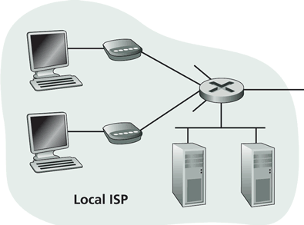
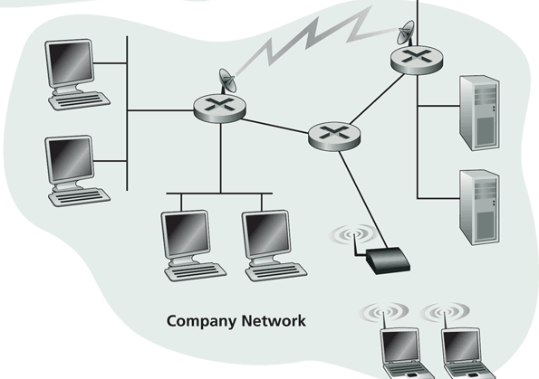
First-Day Class: Internet Physical Infrastructure
Residential access
Cable, Fiber, DSL, Wireless
ISP
Backbone ISP
ISP
The Internet is a network of networks
Each individually administrated network is called an Autonomous System (AS)
data center
Campus access, e.g.,
Ethernet
Wireless
https://www.google.com/loon/how/

Slide 68
First-Day Class: General Complexity
Complexity in highly organized systems arises primarily from design strategies intended to create robustness to uncertainty in their environments and component parts.
Scalability is robustness to changes to the size and complexity of a system as a whole.
Evolvability is robustness of lineages to large changes on various (usually long) time scales.
Reliability is robustness to component failures.
Efficiency is robustness to resource scarcity.
Modularity is robustness to component rearrangements.
David Meyer

Slide 69
First-Day Class: Evolution
Driven by Technology, Infrastructure, Policy, Applications (usage), and Understanding:
technology
e.g., wireless/optical communication technologies and device miniaturization (sensors)
infrastructure
e.g., cloud computing vs local computing
applications (usage)
e.g., mobile computing, content distribution, game, tele presence, sensing
understanding
e.g., resource sharing principle, routing principles, mechanism design, optimal stochastic control (randomized access)
Complexity comes from evolution.
Don’t be afraid to challenge the foundation and redesign!

Slide 70


Slide 71
Optional Read: Channel Partitioning MAC

Slide 72
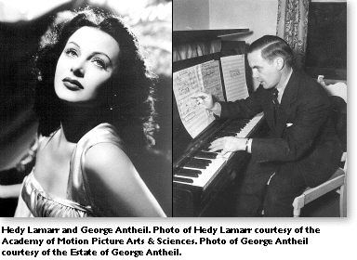
Example Channel Partitioning: CDMA
CDMA (Code Division Multiple Access)
Used mostly in wireless broadcast channels (cellular, satellite, etc)
A spread-spectrum technique
History: http://people.seas.harvard.edu/~jones/cscie129/nu_lectures/lecture7/hedy/lemarr.htm
Examples: Sprint and Verizon, WCDMA

Slide 73
CDMA: Encoding
All users share same frequency, but each user m has its own unique “chipping” sequence (i.e., code) c_{m} to encode data, i.e., code set partitioning
e.g. c_{m} = 1 1 1 -1 1 -1 -1 -1
Assume original data are represented by 1 and -1
Encoded signal = (original data) modulated by (chipping sequence)
assume c_{m} = 1 1 1 -1 1 -1 -1 -1
if data is d, send d c_{m},
if data d is 1, send c_{m}
if data d is -1 send -c_{m}

Slide 74
CDMA: Encoding
t_{b}
user data d(t)
1
-1
X
t_{c}
chipping
sequence c(t)
-1
1
1
-1
1
-1
1
-1
1
1
-1
1
-1
1
=
resulting
signal
-1
1
1
-1
1
-1
1
1
-1
-1
1
-1
1
-1
t_{b}: bit period
t_{c}: chip period

Slide 75
CDMA: Decoding
Inner-product (summation of bit-by-bit product) of encoded signal and chipping sequence
if inner-product > 0, the data is 1; else -1

Slide 76
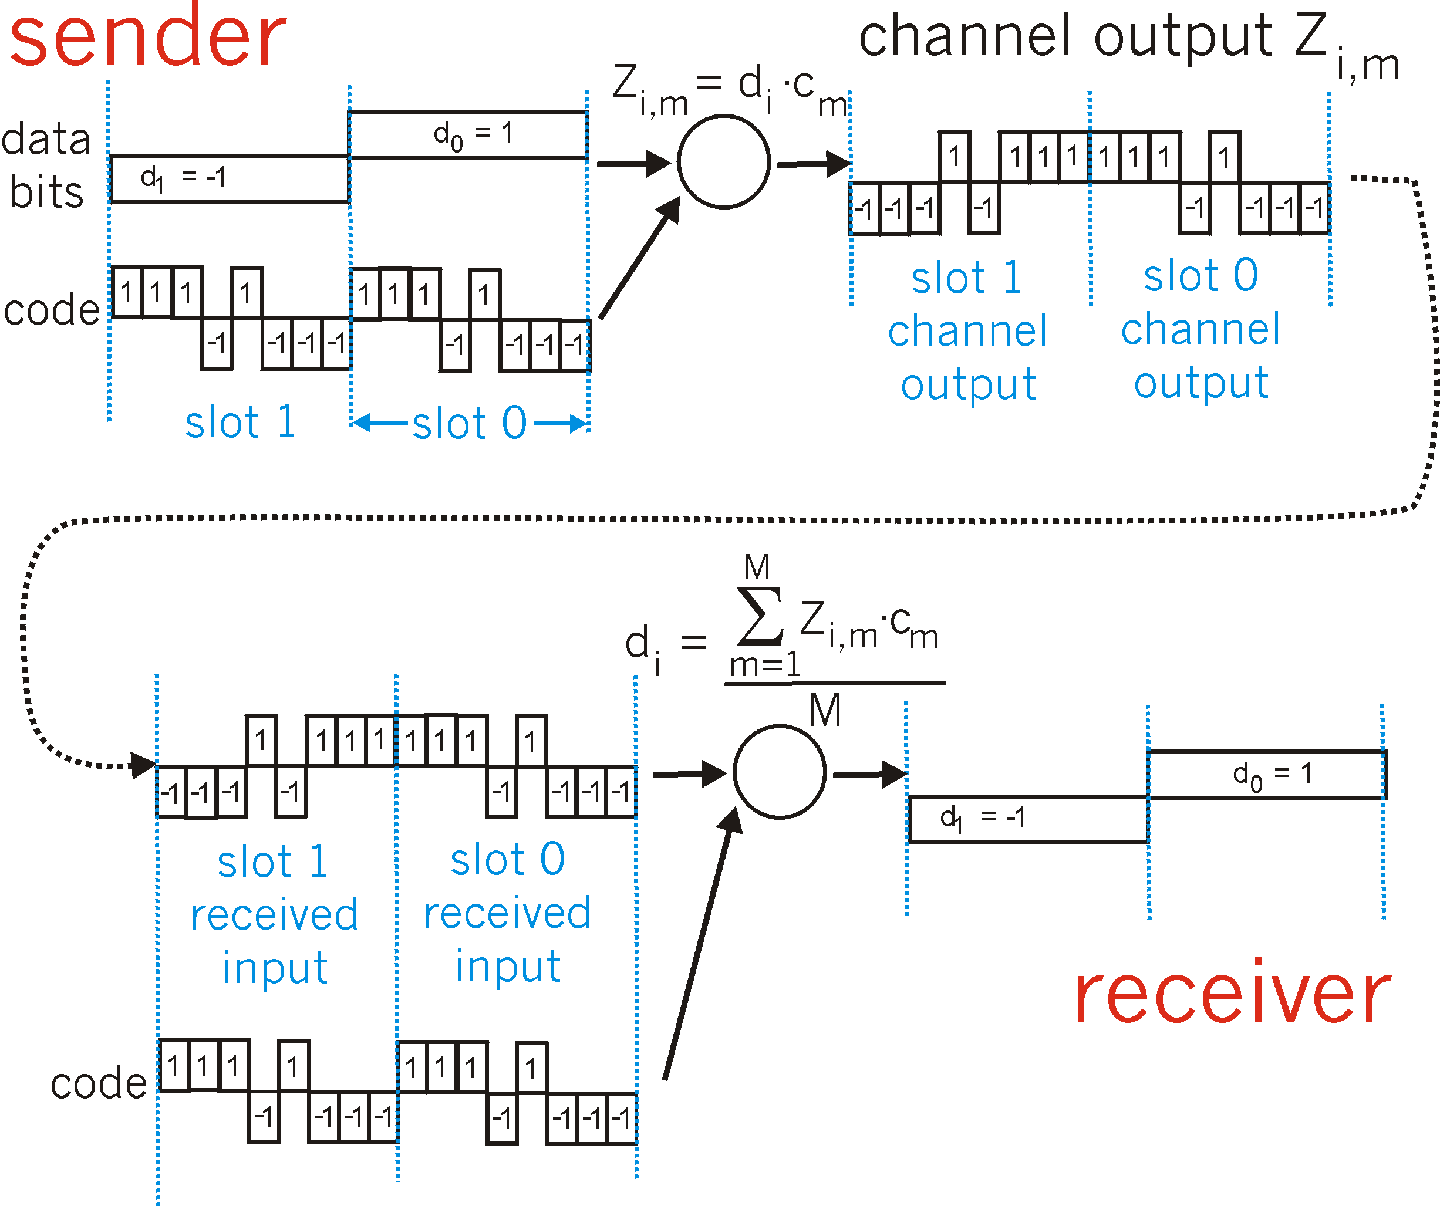
CDMA Encode/Decode
Encode
Code of user m c_{m}: 1 1 1 -1 1 -1 -1 -1
Decode
The number of bits of each chipping sequence is M

Slide 77
CDMA: Deal with Multiple-User Interference
Two codes C_{i} and C_{j} are orthogonal, if
, where we use “.” to denote inner product, e.g.
If codes are orthogonal, multiple users can “coexist” and transmit simultaneously with minimal interference:
C₁: 1 1 1 -1 1 -1 -1 -1
C₂: 1 -1 1 1 1 -1 1 1
-----------------------------------------
C₁ . C₂ = 1 +(-1) + 1 + (-1) +1 + 1+ (-1)+(-1)=0
Analogy: Speak in different languages!

Slide 78
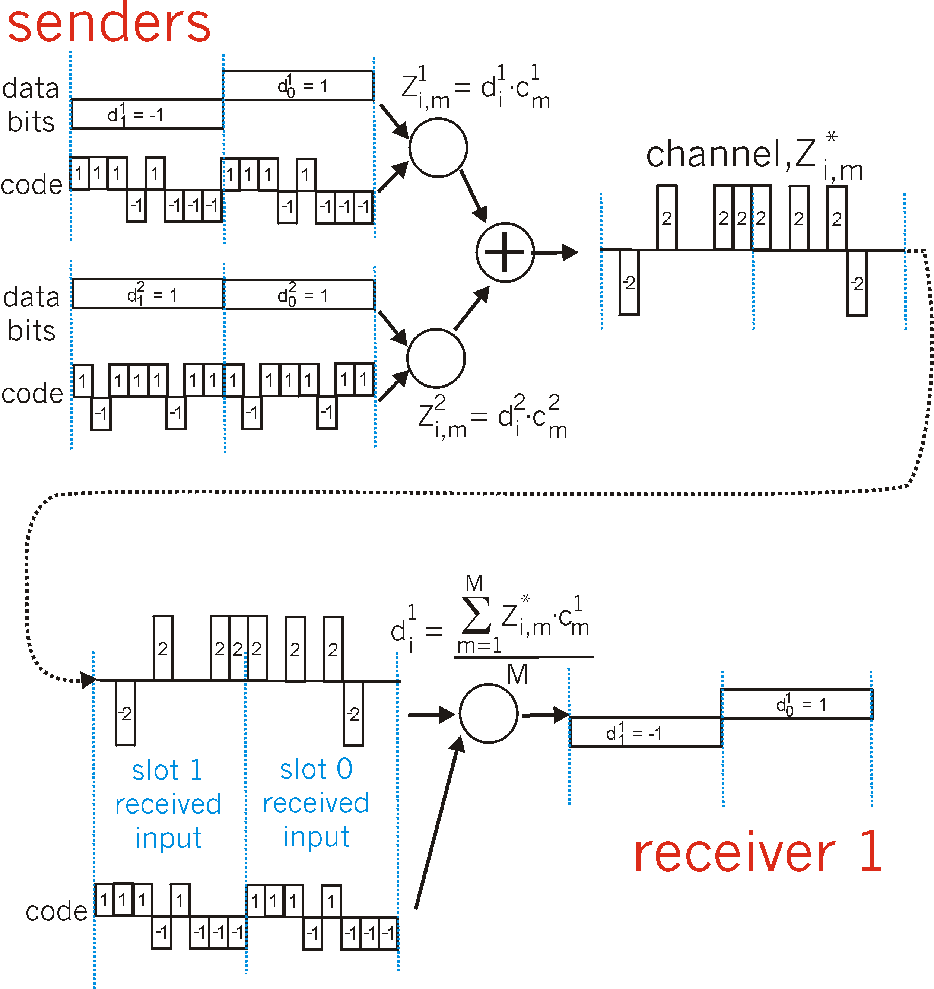
CDMA: Two-Sender Interference
Code 1: 1 1 1 -1 1 -1 -1 -1
Code 2: 1 -1 1 1 1 -1 1 1

Slide 79
Generating Orthogonal Codes
The most commonly used orthogonal codes in current CDMA implementation are the Walsh Codes

Slide 80
Walsh Codes
1,1,1,1,1,1,1,1
1,1,1,1
...
1,1,1,1,-1,-1,-1,-1
1,1
1,1,-1,-1,1,1,-1,-1
1,1,-1,-1
...
X,X
1,1,-1,-1,-1,-1,1,1
X
1
1,-1,1,-1,1,-1,1,-1
X,-X
1,-1,1,-1
...
1,-1,1,-1,-1,1,-1,1
n
2n
1,-1
1,-1,-1,1,1,-1,-1,1
1,-1,-1,1
...
1,-1,-1,1,-1,1,1,-1
1
2
4
8

Slide 81
Orthogonal Variable Spreading Factor (OSVF)
Variable codes: Different users use different lengths spreading codes
Orthogonal: diff. users’ codes are orthogonal
1,1,1,1,1,1,1,1
1,1,1,1
...
1,1,1,1,-1,-1,-1,-1
1,1
1,1,-1,-1,1,1,-1,-1
1,1,-1,-1
...
X,X
1,1,-1,-1,-1,-1,1,1
X
1
1,-1,1,-1,1,-1,1,-1
X,-X
1,-1,1,-1
...
1,-1,1,-1,-1,1,-1,1
SF=n
SF=2n
1,-1
1,-1,-1,1,1,-1,-1,1
1,-1,-1,1
...
1,-1,-1,1,-1,1,1,-1
SF=1
SF=2
SF=4
SF=8
If user 1 is given code [1,1], what orthogonal codes can we give to other users?
Notes:
No parent-child on the code tree

Slide 82
WCDMA Orthognal Variable Spreading Factor (OSVF)
Flexible code (spreading factor) allocation
up link SF: 4 – 256
down link SF: 4 - 512
WCDMA downlink
Notes:
No parent-child on the code tree

Slide 83
Combined Random Access + Channel Partition: GSM Logical Channels and Request
call setup from an MS
MS
BTS
Control channels
Broadcast control channel (BCCH)
from base station, announces cell identifier, synchronization
Common control channels (CCCH)
paging channel (PCH): base transceiver station (BTS) pages a mobile host (MS)
random access channel (RACH): MSs for initial access, slotted Aloha
access grant channel (AGCH): BTS informs an MS its allocation
Dedicated control channels
standalone dedicated control channel (SDCCH): signaling and short message between MS and an MS
Traffic channels (TCH)
RACH (request signaling channel)
AGCH (assign signaling channel)
SDCCH (request call setup)
SDCCH message exchange
SDCCH (assign TCH)
Communication

Slide 84
Discussions
Advantages of channel partitioning over random access
Advantages of random access over channel partitioning

Slide 85
Backup Slides: Physical Layer

Slide 86
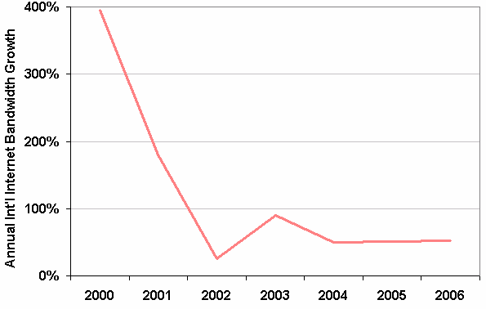
Internet Bandwidth Growth
Source: TeleGeograph Research
86

Slide 87
What Determines Transmission Rate?
Service: transmit a bit stream from a sender to a receiver
sender
receiver
input
bit stream
Encoding
channel
Decoding
output
bit stream
Question to be addressed: how much can we send through the channel ?
87

Slide 88
Basic Theory: Channel Capacity
The maximum number of bits that can be transmitted per second (bps) by a physical media is:
where W is the frequency range, S/N is the signal noise ratio. We assume Gaussian noise.
88

Slide 89
Fourier Transform
Suppose the period of a data unit is f (=1/T), then the data unit can be represented as the sum of many harmonics (sin(), cos()) with frequencies f, 2f, 3f, 4f, …
A reasonably behaved periodic function g(t), with minimal period T, can be constructed as the sum of a series of sines and cosines:
89

Slide 90
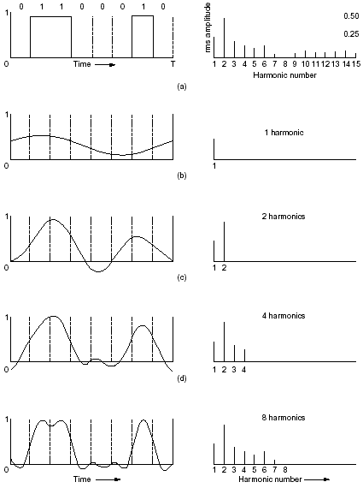
char “b”
90

Slide 91
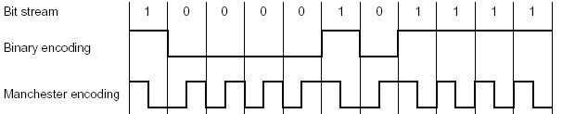
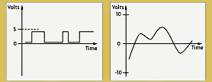
Signal Attenuation
The quality of signal will degrade when it travels
loss, frequency passing
91

Slide 92
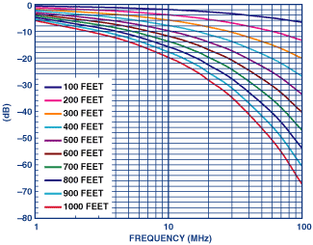
Frequency Dependent Attenuation
The received signal will be distorted even when there is no interference and the transmitted signal is “perfect” square waveform
Example: Voltage-attenuation magnitude ratios of Category 5 cable. For example, 500 feet of cable attenuates a 10-MHz, 1-V signal to 0.32 V, which corresponds to about –9.90 dB (= 20 log 1/0.32)
92

Slide 93
Example
V.34 (33.6kbps Dialup Modem)
channel
sender modem
telephone network
ISP modem
input
bit stream
Modem
Modulation (digit->analog)
3Khz bandwidth (add white noise)
Analog to Digital quantization for transmitting through the digital telephone
backbone
ISP demodulation
output
bit stream
Example: W=3000Hz, S/N ≈ 4000
93

Slide 94
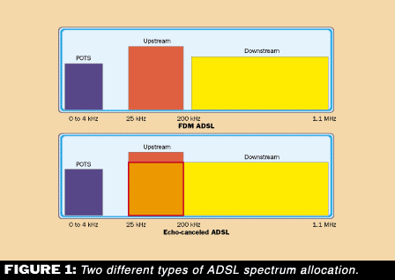
Example: ADSL
Spectrum allocation: divided into a total of 256 downstream and 32 upstream tones, where each tone is a standard 4kHz voice channel
During initial negotiation, a tone is used only if the S/N is above 6 db (≈4)
94

Slide 95
Backup Slides: SDN Control Programming

Slide 96
SDN Programming Model
Service/ Policy
Program Logic
Datapath Model
Datapath Model
Network State

Slide 97
An Example: A Simple SDN Controller
badPort = 22 // policy hostTbl = {A:1,B:2, C:3,D:4} // net view
def onPacketIn(p):
if badPort == p.tcp_dst: drop
else: forward([hostTbl(p.eth_dst)])
1
2
3
4
A
B
C
D
Assume only packets to A,B,C,D can appear.

Slide 98
Controller Program with Flow Table Management
hostTbl = {A:1,B:2,C:3,D:4}
def onPacketIn(p):
if 22 == p.tcp_dst: drop
installRule({‘match':{'tcp_dst':22}, ‘action’:[]})
else: forward([hostTbl(p.eth_dst)])
installRule({‘match’: {‘eth_dst’:p.eth_dst, ’tcp_dst’!=22},
‘action’:[hostTbl(p.eth_dst)]})
match does not support logic negation

Slide 99
Controller Program with Flow Table Management
hostTbl = {A:1,B:2,C:3,D:4}
def onPacketIn(p):
if 22 == p.tcp_dst: drop
installRule({‘priority’:1, ‘match’:{'tcp_dst':22}, ‘action’:[]})
else: forward([hostTbl(p.eth_dst)])
installRule({‘priority’:0, ‘match’: {‘eth_dst’:p.eth_dst},
‘action’:[hostTbl(p.eth_dst)]})

Slide 100
Does the Program Work?
Switch
EthDst:A,
TcpDst:80
{`priority`:0,’match’:{‘eth_dst’:A},'action':[1]}
EthDst:A,
TcpDst:22
A security bug!
Controller
def onPacketIn(p):
if 22 == p.tcp_dst: drop
installRule({`priority`:1,’match’:{‘tcp_dst':22},'action':[]})
else:
installRule({`priority`:0,’match’:{‘eth_dst’:p.eth_dst},
'action':[hostTbl(p.eth_dst)]})
forward([hostTbl(p.eth_dst)])
Notes:
Unfortunately, this program has a bug. To see where the program goes wrong, let’s watch what happens when we connect this controller to a single switch and let two packets arrive. Both packets have destination mac A. The red packet is to TCP destination 80, while the green packet is to TCP destination 22. When the red packet arrives, the switch has an empty flow table and sends the packet to the controller. The controller determines that the packet should be forwarded to the next hop, and installs the appropriate rule. The red packet returns to the switch and moves onward. Now, the port 22 packet arrives at the switch, and instead of being dropped or sent to the controller, it matches the low priority rule for Ethernet destination A and is therefore forwarded onward. This violates the user’s intentions and may represent a security violation.

Slide 101
OVS Approach: Using Exact Match
hostTbl = {A:1,B:2,C:3,D:4}
def onPacketIn(p):
if 22 == p.tcp_dst: drop
installRule({‘priority’:1, ‘match’:exactMatch(p), ‘action’:[]})
else: forward([hostTbl(p.eth_dst)])
installRule({‘priority’:0, ‘match’:exactMatch(p),
‘action’:[hostTbl(p.eth_dst)]})

Slide 102
Problems of OVS Approach
Each new TCP flow delayed for flow setup (10-100 ms)
Number of flow table rules may exceed capacity (typically a few thousands)

Slide 103
Outline
Admin and recap
Link layer
Software defined networking
Motivation: from simple forwarding to network functions
Design overview
Data path (OpenFlow)
Control path (programming model)
Problems
Algorithmic network programming

Slide 104
Goal of SDN Programming
Let programmers write the most obvious (=> data path independent) code:
Design a system that can automatically generate correct, highly-optimized data path.
def onPacketIn(p) if 22 == p.tcp_dst: drop
else: forward([hostTbl(p.eth_dst)])

Slide 105
Algorithmic SDN Programming Abstraction: Programmer’s View
Conceptually programmer’s network control function f is invoked on every packet entering the network.
f expressed in an existing, general purpose language (e.g., Java, Python), describing how a packet should be routed, not how data path flow tables are configured
f: packet route

Slide 106
Example Algorithmic Policy in Java
Route f(Packet p) {
if (p.tcpDstIs(22)) return null();
else {
Location sloc = hostTable(p.ethSrc());
Location dloc = hostTable(p.ethDst());
Route path = myRoutingAlg(topology(), sloc,dloc);
return path;
}
}
Route myRoutingAlg(Topology topo, Location sLoc, Location dloc) {
if ( isSensitive(sLoc) || isSensitive(dLoc) ) return secureRoutingAlg(topo, sloc, dloc);
else return standardRoutingAlg(topo, sloc, dloc);
}
Does not specify anything on flow tables!
Notes:
Here is an example algorithmic program, written in Java.
Explain program.
Note that the program does not specify flow table configuration.
So the programming model makes the programmer’s life easy: just take a packet and say what to do with it.

Slide 107
More Complex Example: ACL+Routing
void insert(ACLItem acl, int pos, List<ACLItem> acls) {
acls.add(pos, acl);
}
void delete(int pos, List<ACLItem> acls) {
acls.remove(pos);
}
boolean permit(Packet p, List<ACLItem> acls) {
for (ACLItem item : acls) {
if ( match(p, item) ) {
return item.action == PERMIT;
} }
return false;
}
List<ACLItem> acls;
Route f(Packet p) {
if ( ! permit(p, acls) ) {
return null();
}
Location sloc = hostTable(p.ethSrc());
Location dloc = hostTable(p.ethDst());
Route path = myRoutingAlg(topology(),sloc,dloc);
return path;
}

Slide 108
Challenge and Basic Idea
Challenge: How to derive datapath (flow-tables) from a datapath-oblivious SDN controller function f?
Basic idea of handling the challenge w/o a compiler:
There are two representations of computation
A sequence of instructions (whitebox)
Memorization tables (blackbox)
Although the decision function f does not specify how flow tables are configured, if for a given decision (e.g., drop), one know the dependency of the decision, one can construct the flow tables (aka, memorization tables).
Notes:
On the other hand implementing algorithmic policies is challenging.
We know that naive solutions -- process every packet at controller or use only exact match rules -- perform poorly.
Static analysis to determine layout of flow tables is possible, but has drawbacks; in particular static analysis of general purpose language programs is typically conservative. Furthermore, relying on static analysis will cause the system to become substantially dependent on the source language in which we write algorithmic policies.

Slide 109
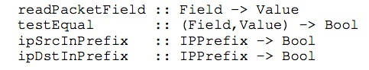
Basic Idea
Only requirement: Program f uses a simple library to access pkt attributes:
Library provides both convenience and more importantly, decision dependency!

Slide 110
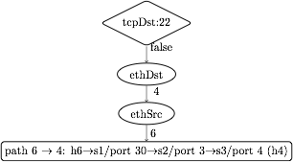
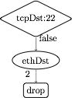
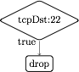
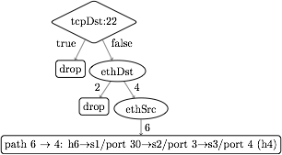
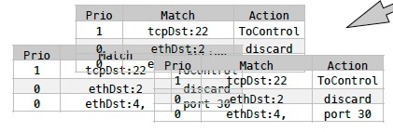
Dynamic Tracing: Abstraction to Flow Tables
1. Observes decision dependency of f on pkt attributes.
2. Builds a trace tree (TT), a universal (general), partial decision tree representation of any f.
3. Compile trace tree to generate flow tables (FTs).
Notes:
Instead, we introduce Maple, a system that implements algorithmic policies using a fully dynamic compilation method and which does not depend on the source language used to express the algorithmic policy.
Maple works by repeatedly executing the user’s algorithmic policy f on packets entering the network, generalizing the outcome to other packets by observing traces of data accesses made during the execution.
Maple then accumulates these traces into a trace tree, which is a partial decision tree of the input algorithmic policy, f.
Finally, Maple compiles flow tables (FTs) for all the switches in the network from the trace tree. The compilation is done so that packets for which Maple has not yet successfully inferred a forwarding decision are sent back to the controller to ensure that Maple continues to execute f and refine its trace tree.

Slide 111
Policy
EthSrc:1,
EthDst:2,
TcpDst:80
Route f(Packet p) {
if (p.tcpDstIs(22))
return null();
else {
Location sloc =
hostTable(p.ethSrc());
Location dloc =
hostTable(p.ethDst());
Route path =
myRoutingAlg(
topology(),sloc,dloc);
return path;
}
}
Assert: TcpDst==22
false
Read: EthSrc
1
Read: EthDst
2
path1
Notes:
We use the example Java algorithmic policy to illustrate the tracing method. Suppose Maple executes the algorithmic policy on a packet with Ethernet source 1, Ethernet dest 2 and tcp destination 80. As the packet moves through the policy, Maple collects a trace of the execution.
When this packet arrives at the check on tcp destination, Maple records the assertion, and its outcome. In this case, the outcome is false. The program proceeds to the else branch, where it reads the source and destination addresses, both of which Maple logs. Finally, the program returns the computed path.

Slide 112
Policy
Trace Tree
EthDst:1,
TcpDst:22
Route f(Packet p) {
if (p.tcpDstIs(22))
return null();
else {
Location sloc =
hostTable(p.ethSrc());
Location dloc =
hostTable(p.ethDst());
Route path =
myRoutingAlg(
topology(),sloc,dloc);
return path;
}
}
Assert: TcpDst==22
Assert: TcpDst==22
true
null
true
false
Read: EthSrc
?
1
Read: EthDst
2
path1
Notes:
Maple then uses this trace to begin generating the Trace Tree. In this case, Maple still doesn’t know what will happen if the assertion is true, and it therefore adds a placeholder under the true branch.
Now, if we execute f on a packet to tcp destination 22, the assertion is true, and the packet is dropped. Maple logs this new trace and uses it to refine its Trace Tree, filling in the true branch of the assertion.

Slide 113
Policy
Trace Tree
EthDst:1,
TcpDst:22
Route f(Packet p) {
if (p.tcpDstIs(22))
return null();
else {
Location sloc =
hostTable(p.ethSrc());
Location dloc =
hostTable(p.ethDst());
Route path =
myRoutingAlg(
topology(),sloc,dloc);
return path;
}
}
Assert: TcpDst==22
Assert: TcpDst==22
true
null
true
false
Read: EthSrc
null
1
Read: EthDst
2
path1
Notes:
Maple then uses this trace to begin generating the Trace Tree. In this case, Maple still doesn’t know what will happen if the assertion is true, and it therefore adds a placeholder under the true branch.
Now, if we execute f on a packet to tcp destination 22, the assertion is true, and the packet is dropped. Maple logs this new trace and uses it to refine its Trace Tree, filling in the true branch of the assertion.

Slide 114
Trace Tree Formal Spec
Assert: TcpDst==22
A tree w/ 4 types of nodes
T node: assertion on packet attributes
V node: multi-way branching on a packet attribute
L node: leaf node labeled w/ action
? node: unknown
TT search: traverse tree for a given packet to determine action or no answer
TT correctness: if TT records an answer for a given packet, the answer is the same as the original algorithm
true
false
Read: EthSrc
?
1
Read: EthDst
2
path1

Slide 115
Trace Tree => Flow Table
tcpDst ==22
True
False
drop
ethDst
match:{tcpDst==22}
4
2
drop
ethSrc
match:{tcpDst!=22, ethDst:2}
6
port 30
match:{tcpDst!=22, ethDst:4,ethSrc:6}
Notes:
The basic compilation algorithm is actually very simple, and we explain it here in the context of an example trace tree. For simplicity the leaves are labeled with switch-specific actions, such as forward on some ports or drop.
The basic algorithm generates one rule for each execution of f, and each execution of f is stored as a path from the root of the trace tree to a leaf. For example, the right-most path in this tree resulted from an execution that observed that tcpDst!=22 and ethDst==4 and ethSrc==6.
The leaf stores the action and the match condition can be obtained from the path from the root to the leaf. In this case, we would want to match on tcpDst!=22, ethDst==4 and ethSrc==6. Of course, as we described earlier, we cannot match on tcpDst!=22, and so instead we will generate a rule at some higher priority that matches on the condition which we wish to negate. This rule, which we call a “barrier rule” ensures that the rule for the execution which we are considering only fires when the condition is false.
We observe that all the rules that require tcpDst!=22 are under the False branch of the assertion node and all the rules that require tcpDst==22 are under the True branch of the assertion node. Therefore, we can determine the priority level of the barrier rule by first generating rules and assigning priorities to the False branch of the node, and then assigning the priority of the barrier rule to have the next higher priority. Then we can assign priorities to the True branch. Hence, by generating rules in-order from False to True, we can correctly assign priorities to rules.
Finally, since the subtree under the True branch may not completely describe how to handle all tcpDst==22 packets, some packets with tcpDst==22 may fall through to the reach the barrier rule. Therefore, the action for the barrier rule must be ToController, so that we can continue to trace f correctly.

Slide 116
Trace Tree => Flow Table
tcpDst ==22
True
False
drop
ethDst
match:{tcpDst==22}
4
2
drop
ethSrc
match:{tcpDst!=22, ethDst:2}
6
port 30
barrier rule:
match:{tcpDst!=22, ethDst:4,ethSrc:6}
match:{tcpDst==22}
action:ToController
_{Priority}

Slide 117
Trace Tree => Flow Table
Simple, classical in-order tree traversal generates flow table rules!
tcpDst ==22
3
1
True
False
2
ethDst
drop
match:{tcpDst==22}
4
2
drop
ethSrc
match:{tcpDst!=22, ethDst:2}
6
port 30
barrier rule:
match:{tcpDst!=22, ethDst:4,ethSrc:6}
match:{tcpDst==22}
action:ToController
_{Priority}

